Slide 1
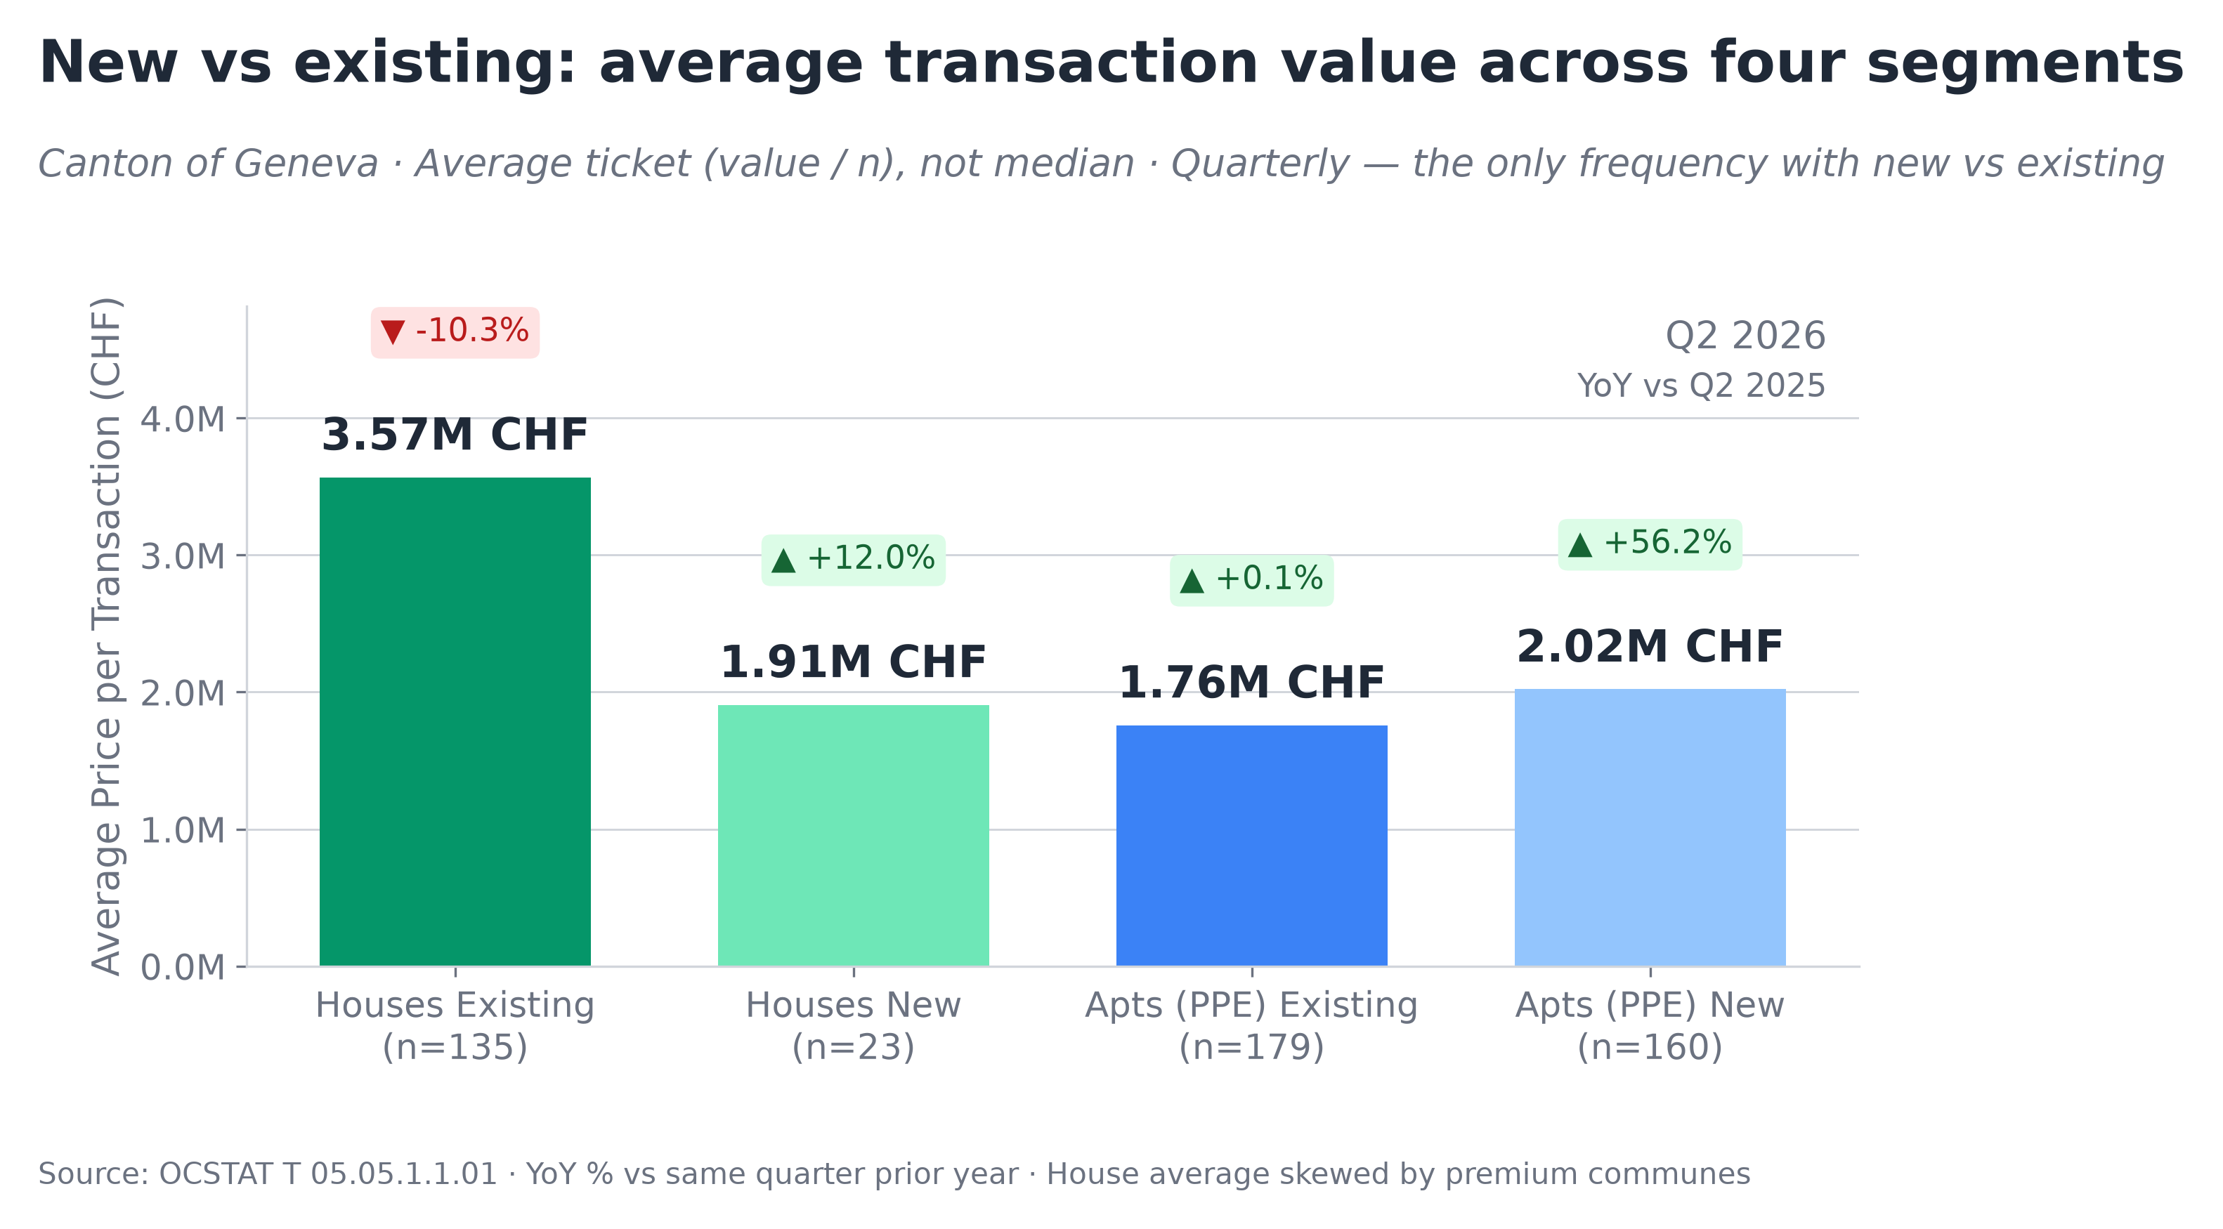
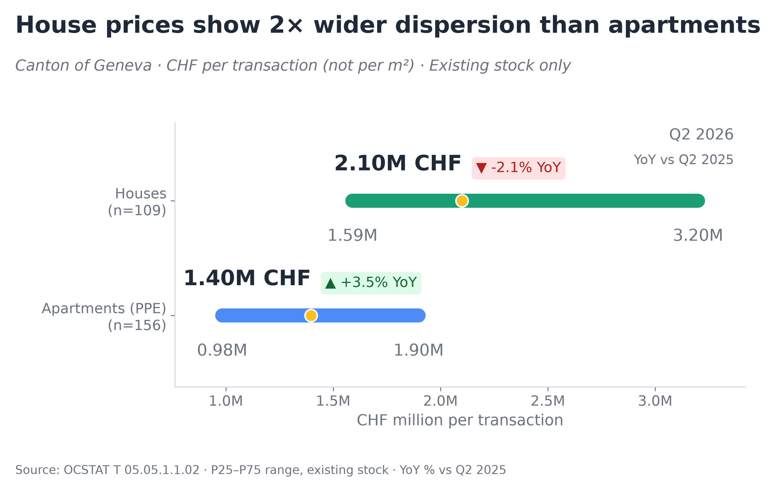
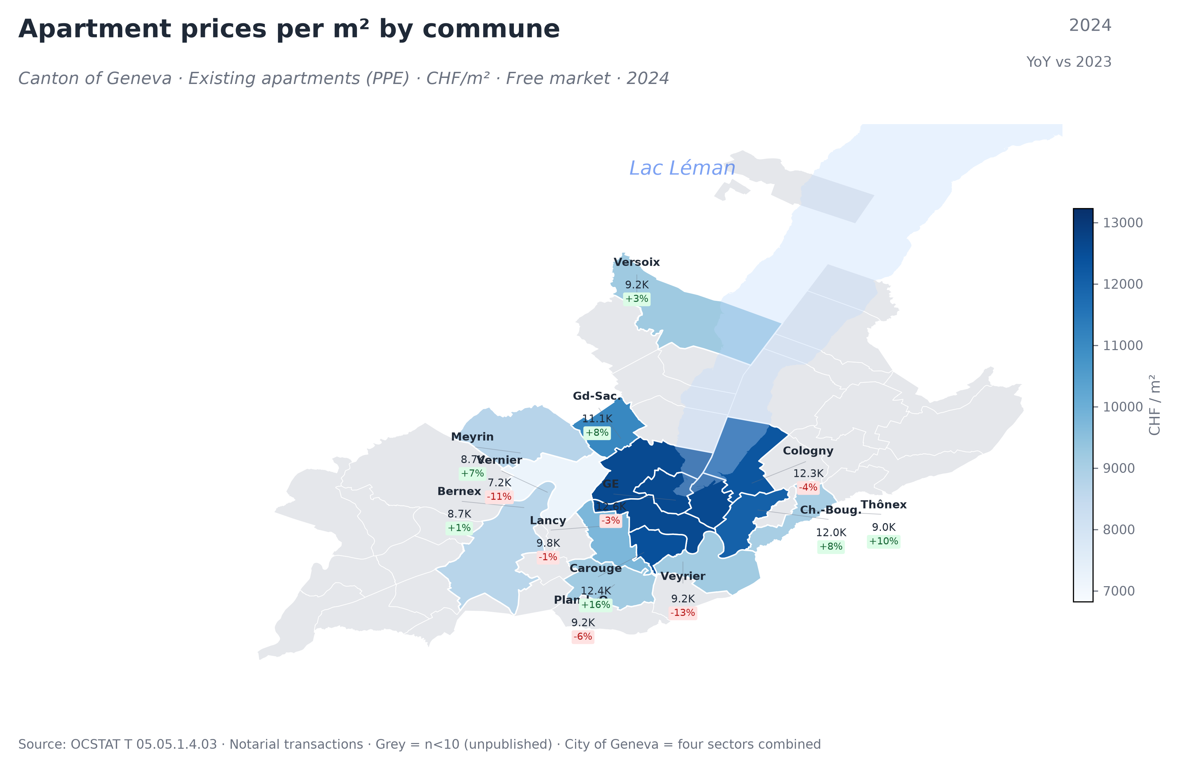
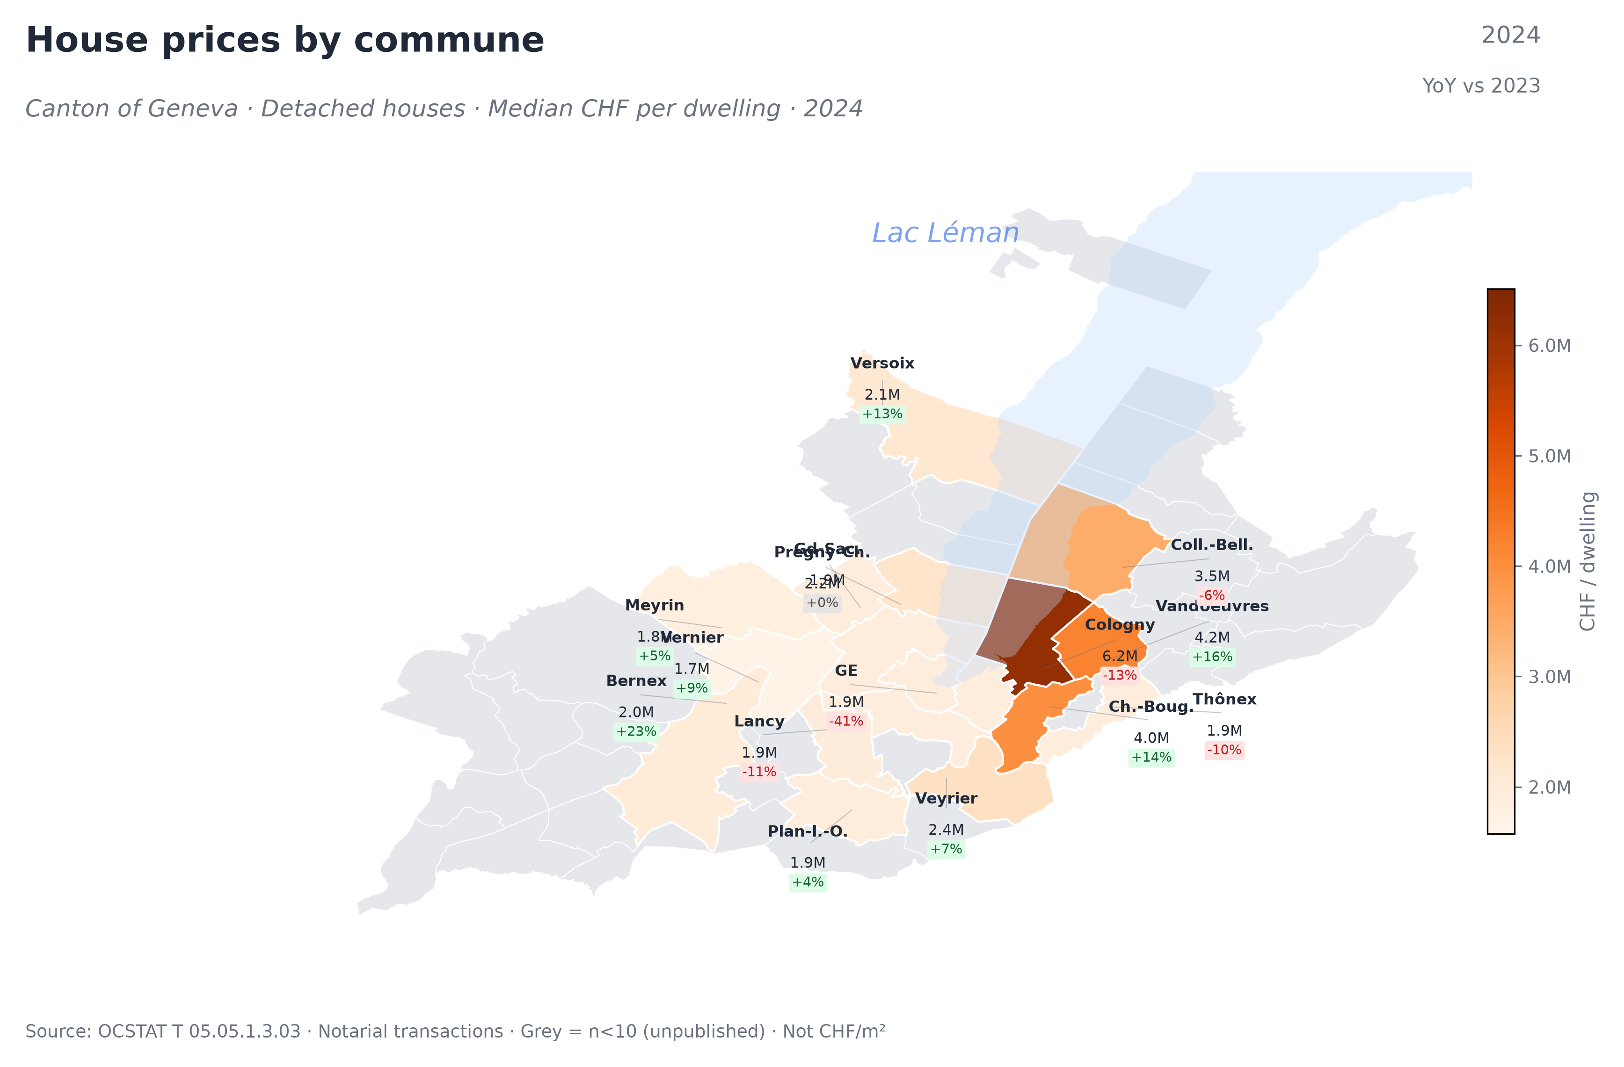
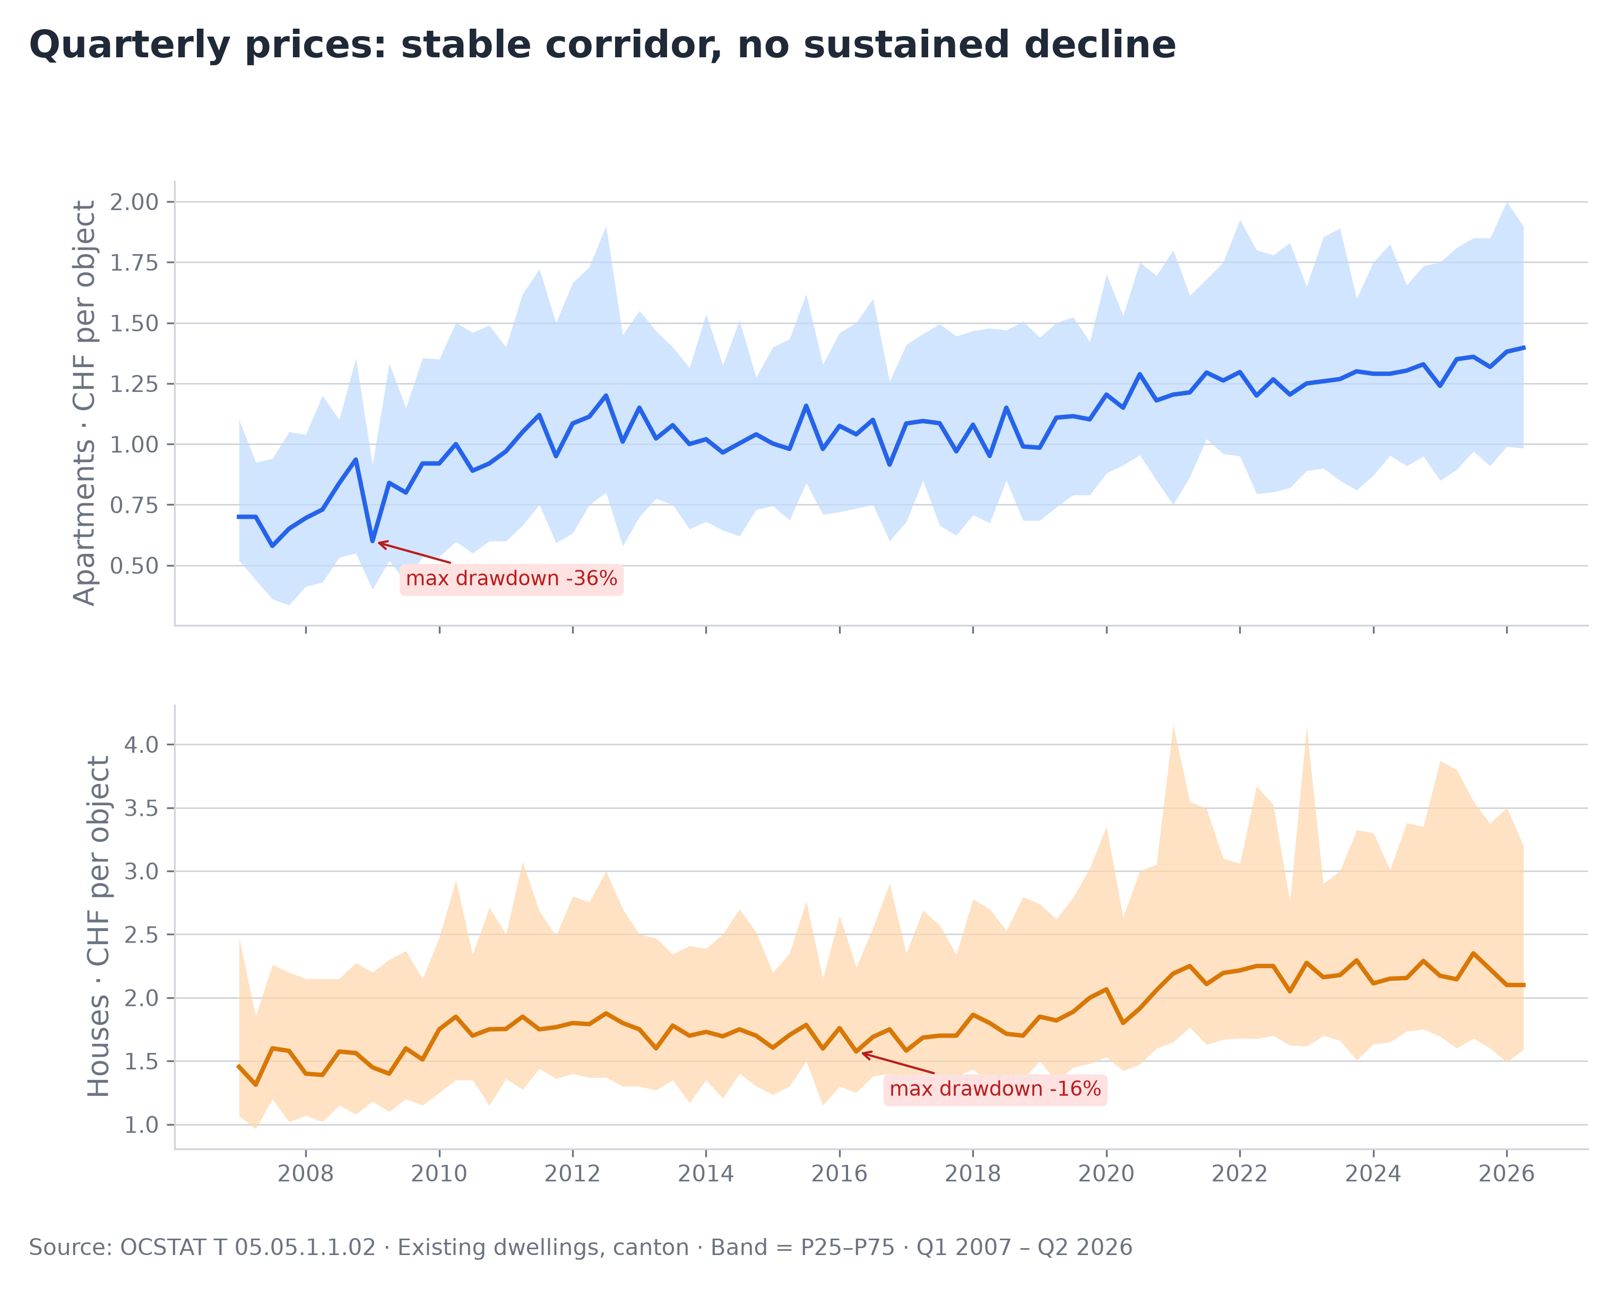
Geneva Canton · Residential Market · Q2 2026
Data Brief
Apartments and houses are two different markets — different metrics, different dynamics.
▸ A house costs on average 2× more than an apartment (3.6M vs 1.8M CHF), but house prices are plateauing while apartments keep rising.
▸ Apartment P75 (~1.9M) meets house P25 (~1.6M) — the decision boundary between a large apartment and a modest house.
▸ All figures are completed notarial transactions (OCSTAT), not listings or appraisals. Left chart: average ticket. Right chart: official OCSTAT medians with P25–P75 range.
▸ Apartments: premium lakeside (Cologny, Chêne-Bougeries: 12–12.5K CHF/m²) vs western suburbs (Vernier, Bernex: 7–9K). A 60m² flat costs 430K in Vernier vs 750K in Cologny.
▸ Houses: Cologny median (6.2M) is 3.7× Vernier (1.7M). Most extreme divergence in the canton.
▸ “New is cheaper” at canton level is a composition effect — new builds concentrate in affordable communes. Within each commune, new costs 17–29% more.
What this brief shows
▸ Apartments in CHF/m² (PPE), houses in CHF per dwelling — different units, never mixed.
▸ Median and quartiles (P25–P75), not averages. Averages shown only where OCSTAT publishes no median.
▸ Communes with n<10 transactions are shown as grey, not zero. Small samples are flagged.
18 years of resilience
▸ Three macro shocks (2008, COVID, 2022 rate hikes) — no sustained median decline. Volumes absorb shocks, prices hold.
▸ House P75 surged +64% in 2021–2023 then retreated — premium segment reacts, median absorbs.
▸ Apartment median continues to climb; house median plateaus in 2026. Two markets are diverging.
Source & reproducibility
▸ OCSTAT T 05.05 series — completed notarial transactions, Canton of Geneva. Published by the cantonal statistics office.
▸ All charts generated from raw data via Python (pandas, matplotlib). Code and methodology available on GitHub.
Source: OCSTAT T 05.05 · Official notarial transactions, Canton of Geneva · Author’s calculations

